Slide 1
Linear Algebra
线性代数
Zongbin Chen YMSC, Tsinghua University
陈宗彬 清华大学数学科学中心
Email: zbchen@tsinghua.edu.can

Slide 2



Quick review
Gauss elimination
Idea: Put the linear system in echelon form with elementary row operations
Elementary row operation（初等行变换）
(Replacement) Replace a row by the sum of itself and a multiple of another row
(Interchange) Interchange two rows
(Scaling) Multiply all entries in a row by a nonzero constant

Slide 3
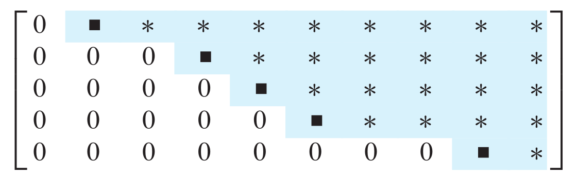
Linear system in echelon form

Slide 4
The row reduction algorithm to reduce a linear system to echelon form
Step 1: Find the left most nonzero column, this is called a pivot column（主列）.

Slide 5
Step 2: Select a nonzero entry in the pivot column as a pivot （主元）, If necessary, interchange rows to move it to the first line.

Slide 6
Step 3: Use row replacement operations to creat zeros in all positions below the pivot.
Repeat step 1–3 to the submatrix under the first line and right to the pivot column.

Slide 7
How to solve linear system in echelon form?

Slide 8
Solve a linear system in upper triangular form by back substitution（回代）

Slide 9
The geometry of vector space
Recall on vector space

Slide 10
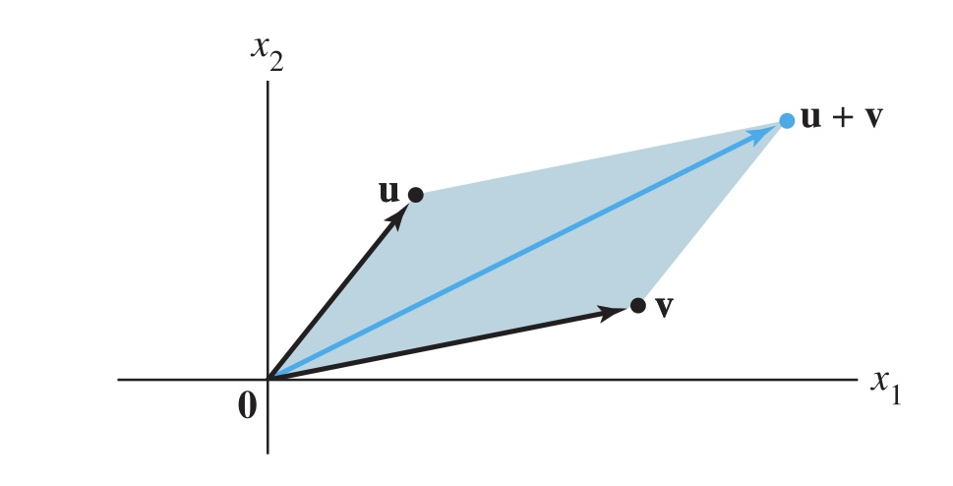
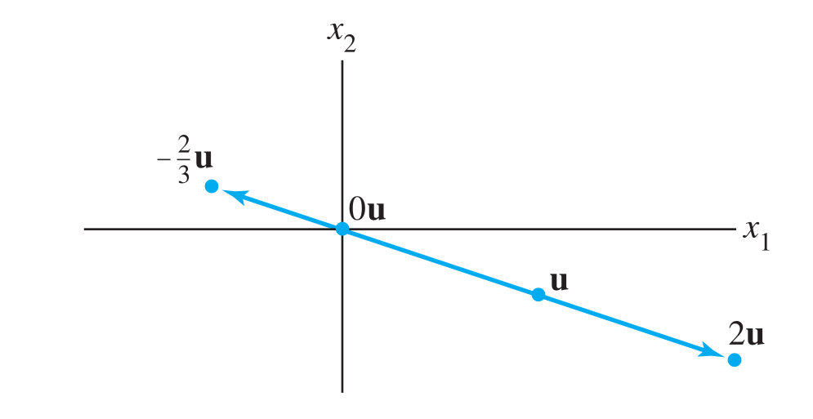
Addition of vectors is described by the rule of parallelogram
Scalar multiplication

Slide 11
Linear combination（线性组合） of vectors
Example

Slide 12
Example

Slide 14
Example
In Euclidean geometry, it is known that the mass center of a triangle is the intersection of the three medians（中线） of the triangle. We can prove it with vector calculus.

Slide 15
Sub vector space（子向量空间）
Example

Slide 16
Sub vector space generated by vectors

Slide 17
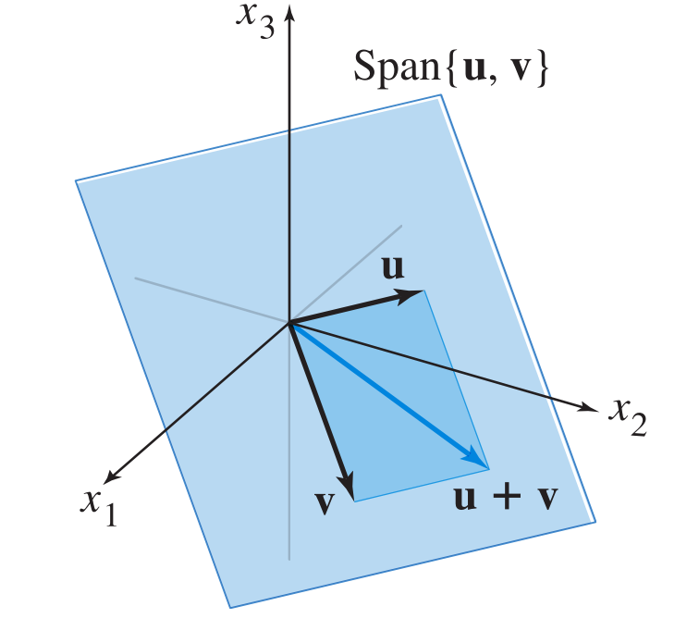
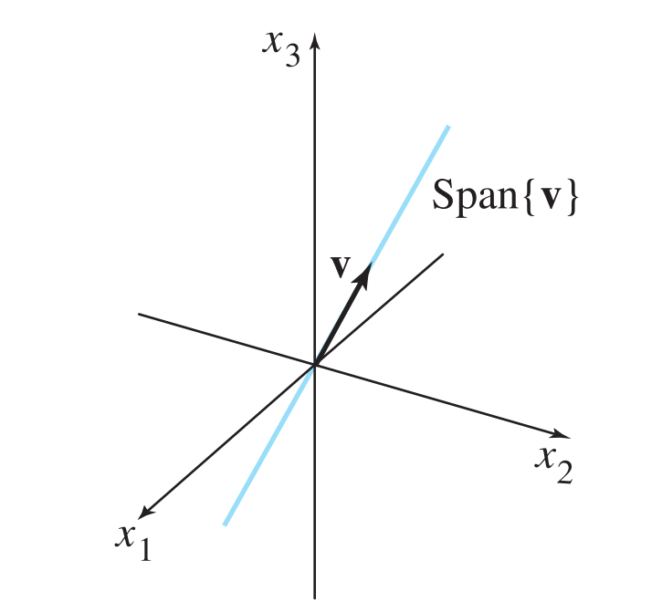
Example

Slide 18
Example

Slide 20
Matrix equation and linear combination of vectors
Three equivalent problems

Slide 21
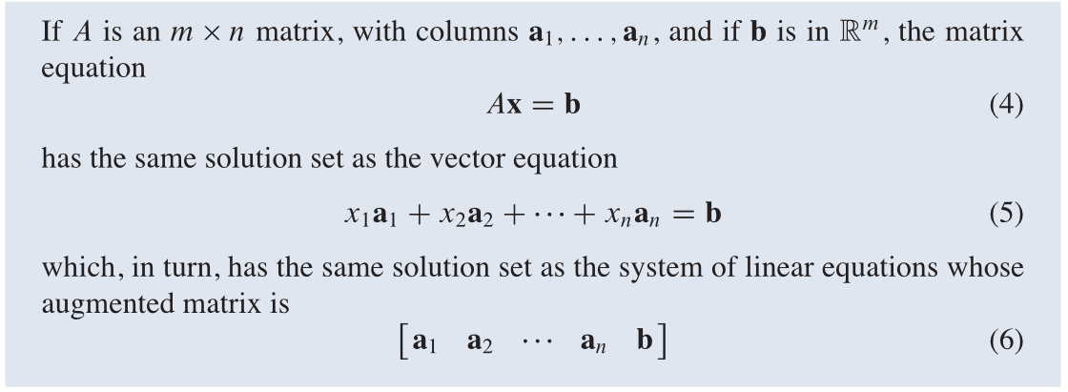
Theorem: The above three equations has the same set of solution. More precisely,

Slide 22
Example

Slide 24
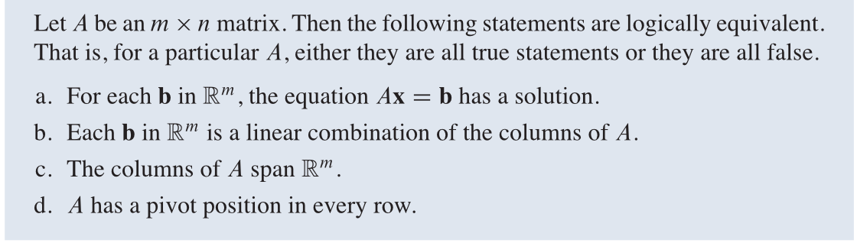

Notice that in the above example, not every vector $b$ in $R^{3}$ lies in the the sub vector space generated by $\overset{⃗}{a_{1}}$, $\overset{⃗}{a_{2}}$, $\overset{⃗}{a_{3}}$, the coordinates of $b$ has to satisfy a condition. This is due to the fact that the echelon form of $A$ has a row of zeros.
In general, we have the following theorem

Slide 25
Example

Slide 26
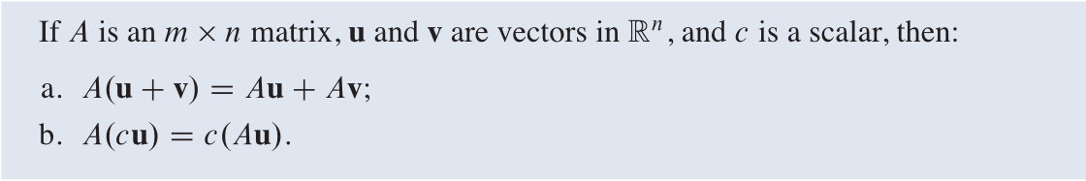
Property of matrix-vector product
In other words, matrix multiplication preserve vector addition and scalar multiplication.

Slide 28
Homework
Lay-Lay-McDonald, 1.3 Exercises, question 19 (geometric description means a necessary and sufficient condition on the coordinates of the vector for it to lie in the plane), question 32.
Lay-Lay-McDonald, 1.4 Exercises, question 13, 18.

Slide 29
Next time
Lay-Lay-McDonald, 1.6-1.7

